Slide 1
PROJECT FINAL REPORT
Project Name: | Institute Management System/IMS
Description: | This project based on Institute management modules like: Student management, Course Management, Exam management etc.
Course: | Full Stack mini Project

Slide 2
Institute Management System
Contains student and course information.
Using JAVA , JSP , Servlets , SQL.
By:- Siddharth Mahla

Slide 3
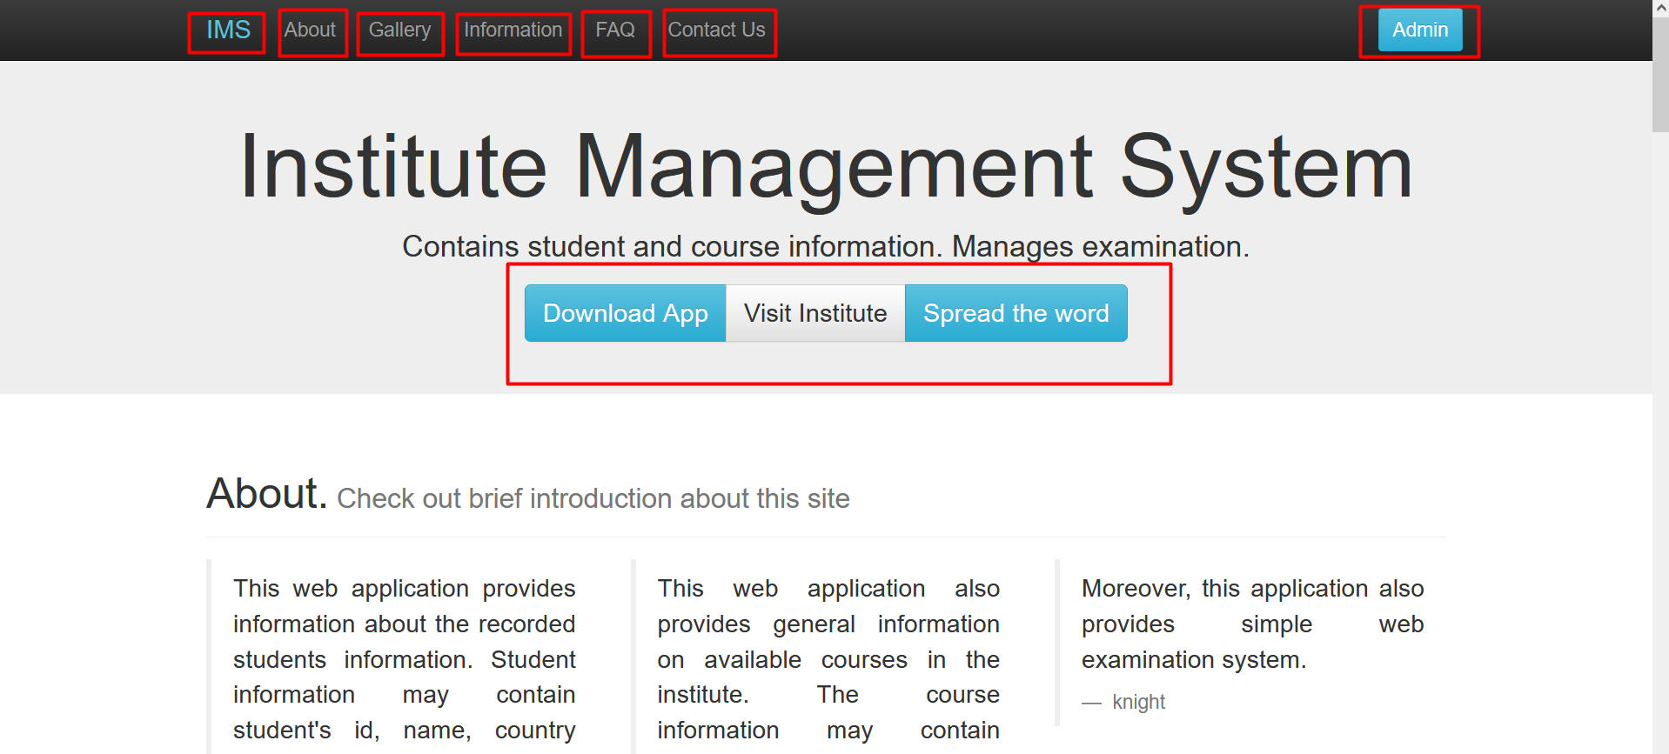
1. Homepage

Slide 4
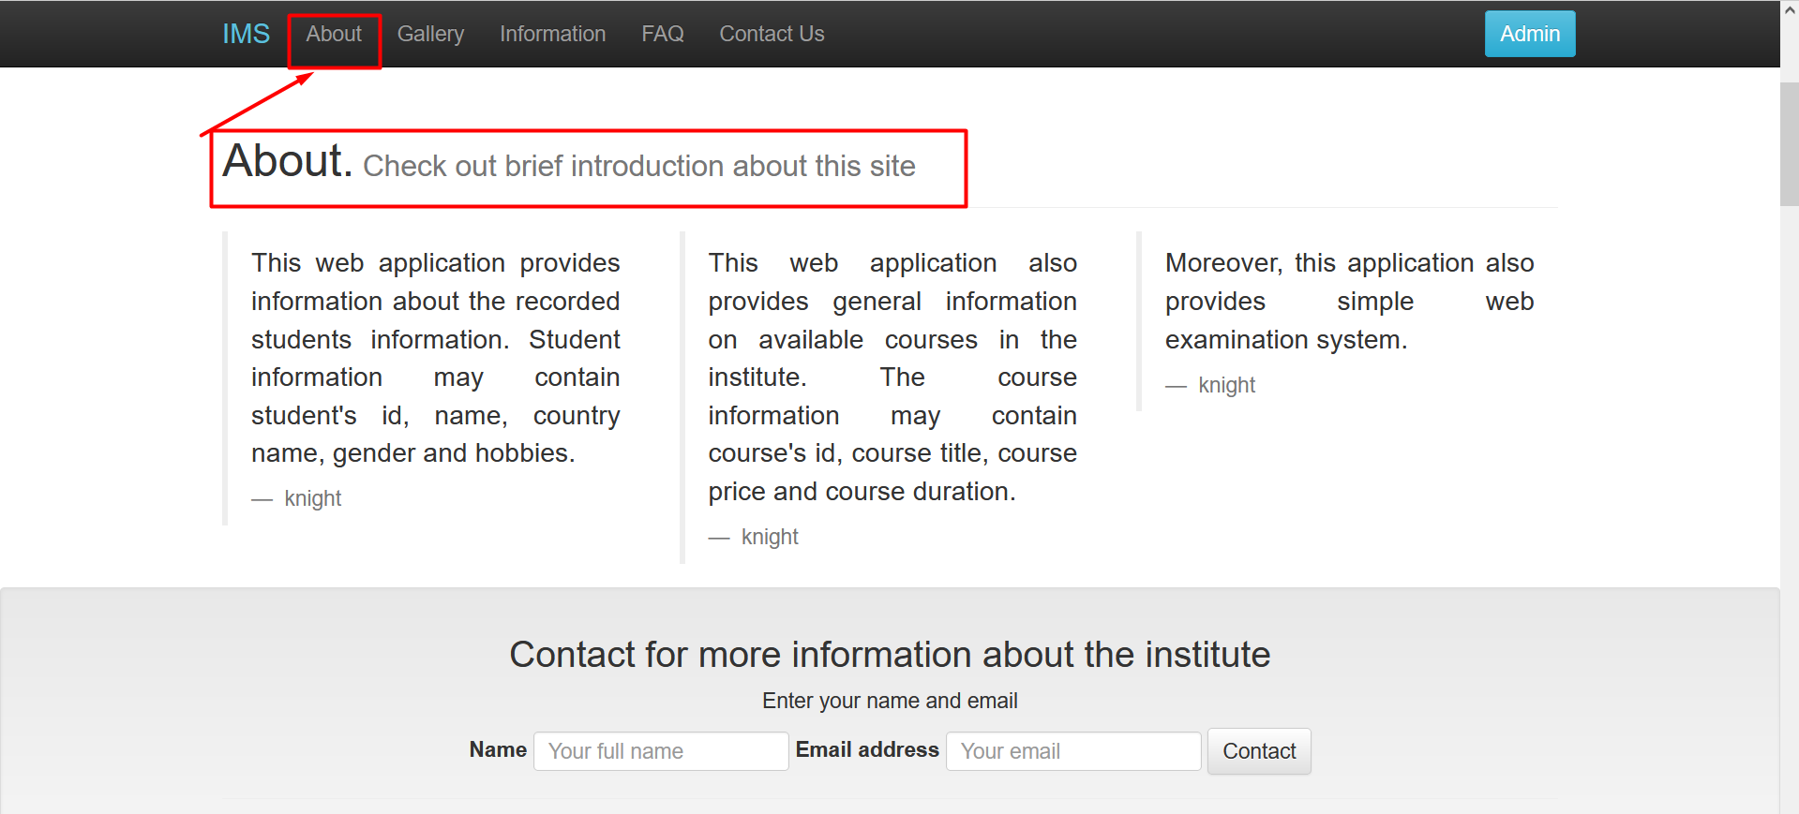
2. About Page

Slide 5
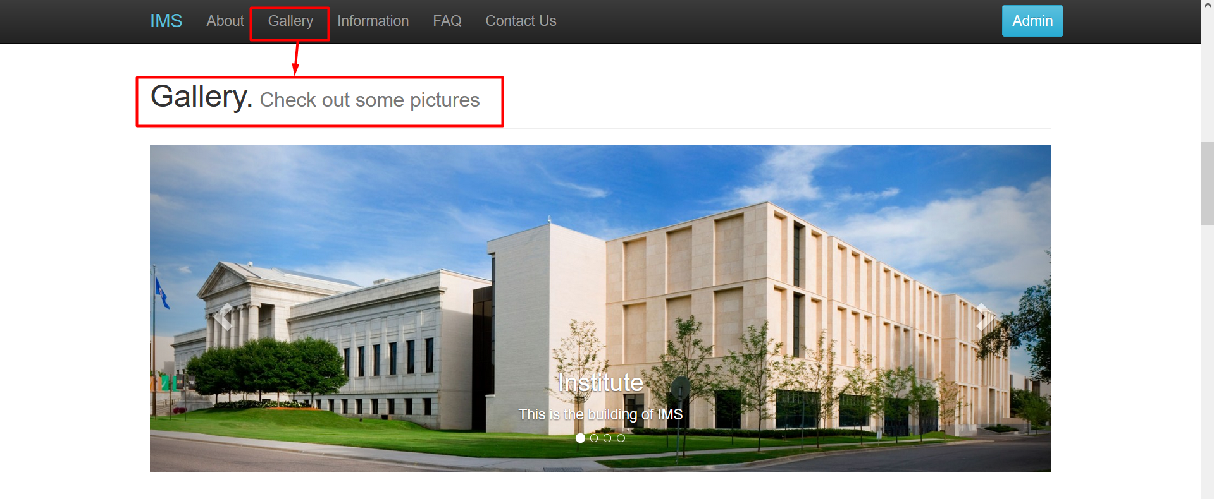
3. Gallery Containing Slid bar with Images

Slide 6
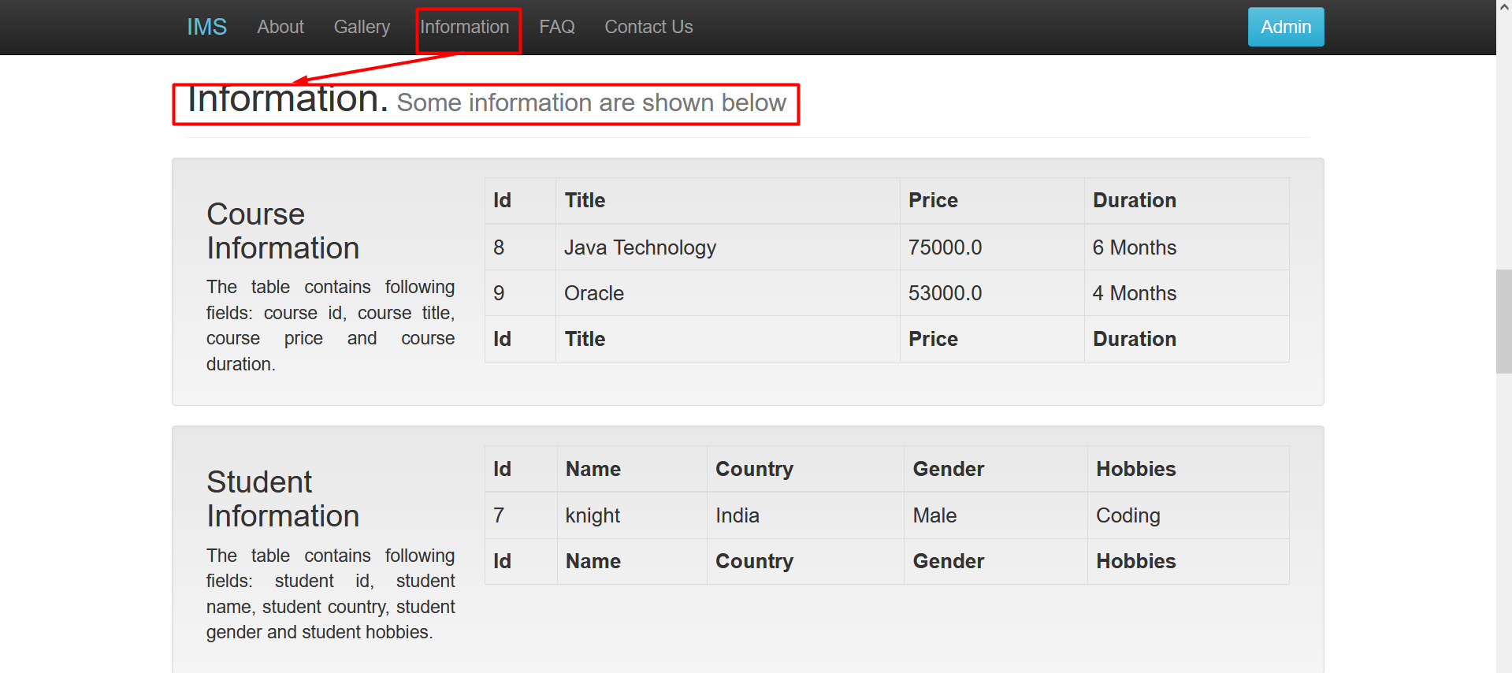
4. Information

Slide 7
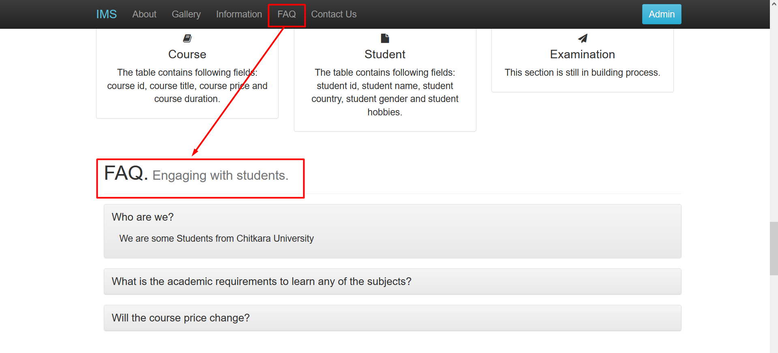
5. FAQ

Slide 8
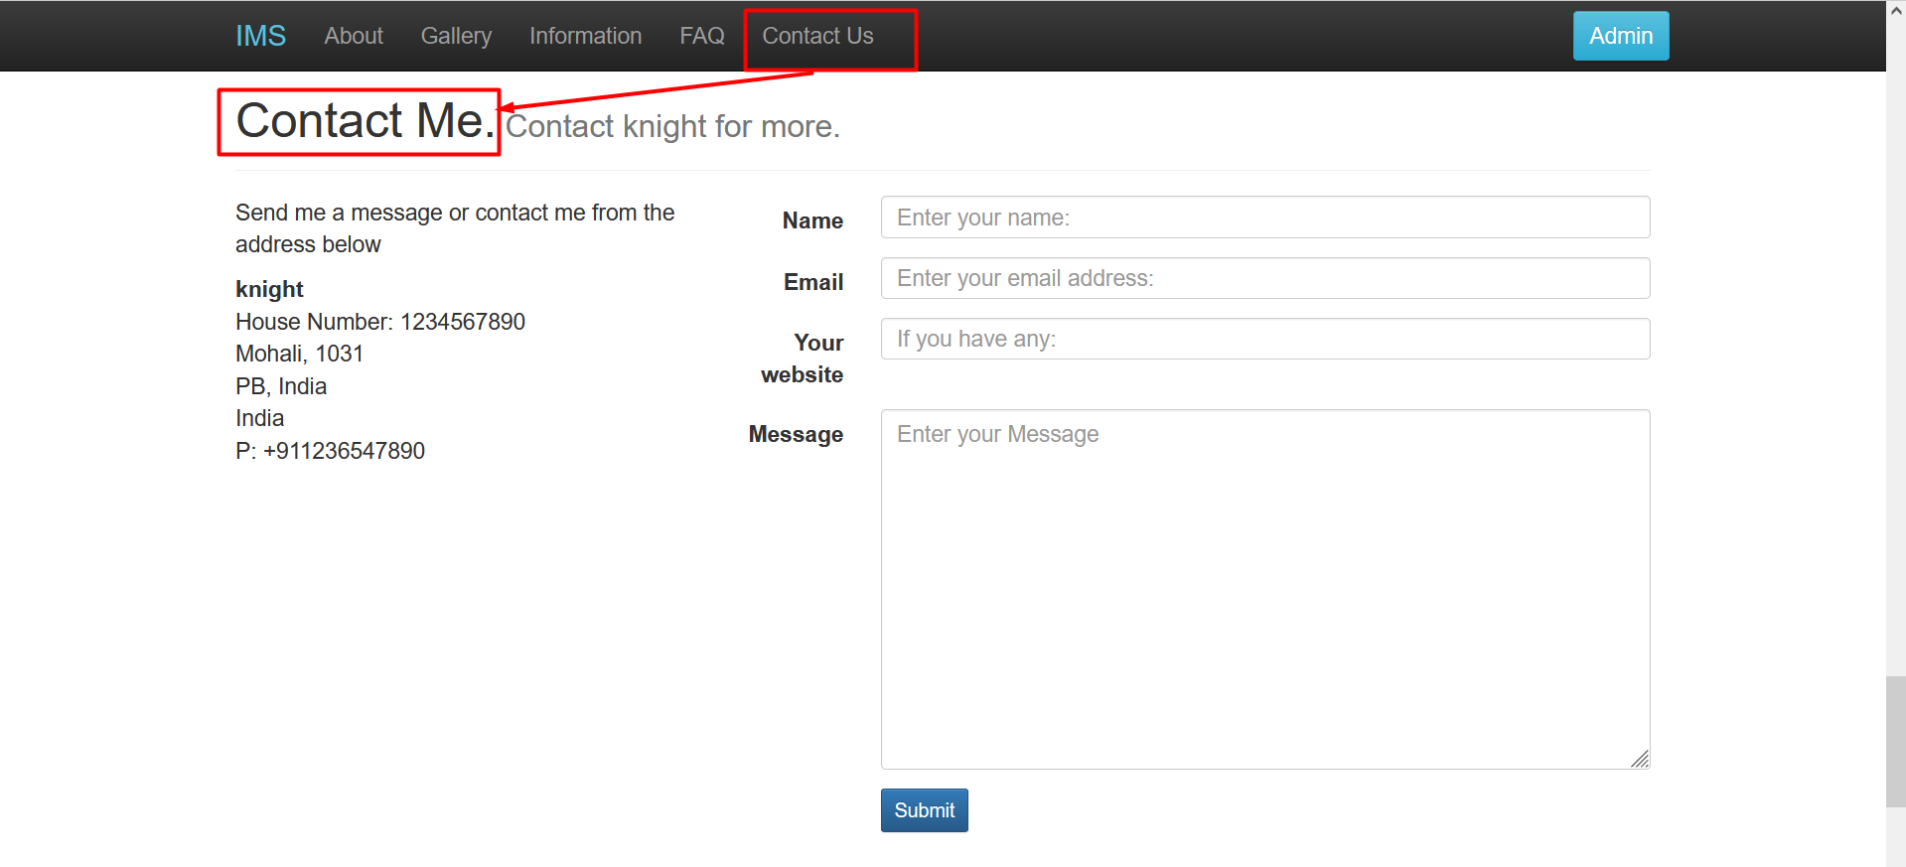
6. Contact Us

Slide 9
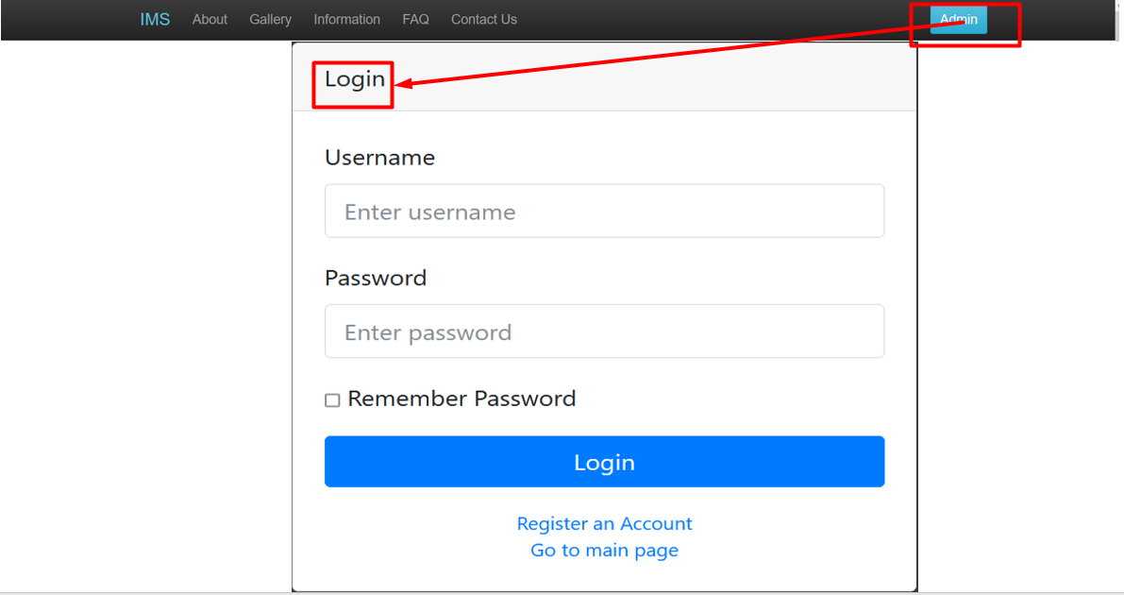
7. Admin
A. Admin login
B. Register user
C. Home Page

Slide 10
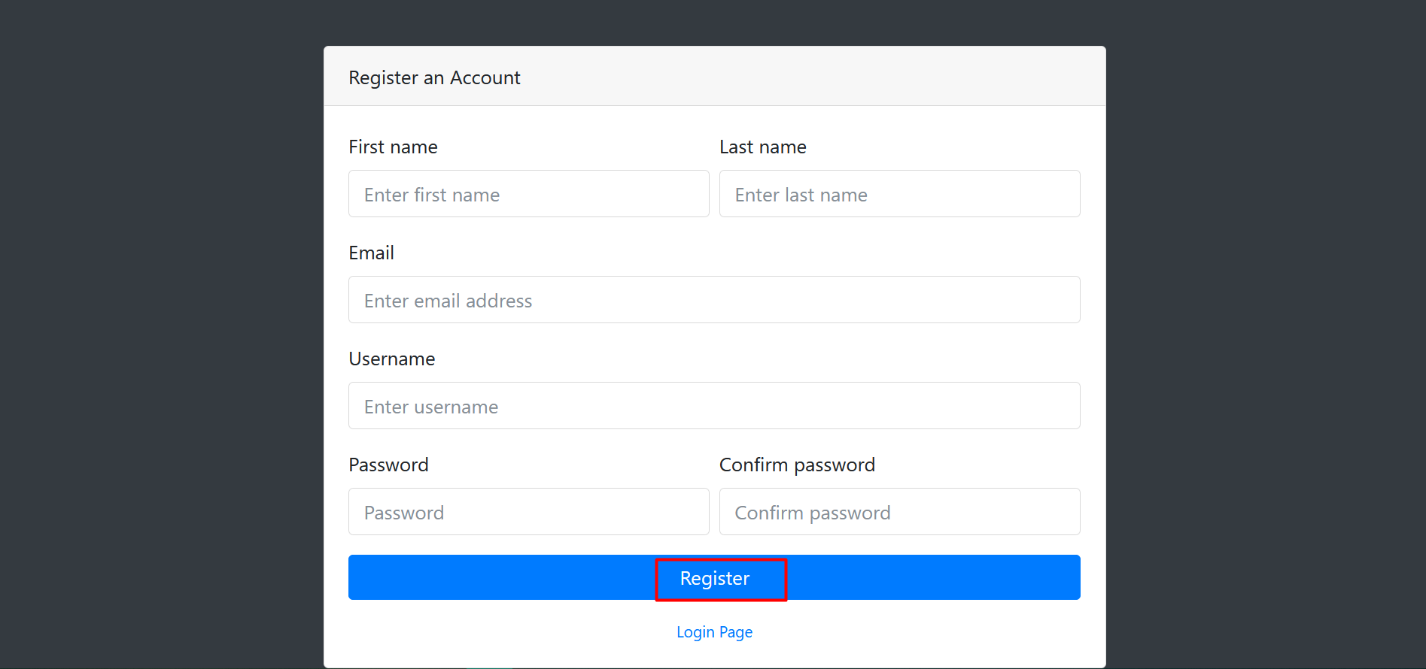
8. Register Page

Slide 11
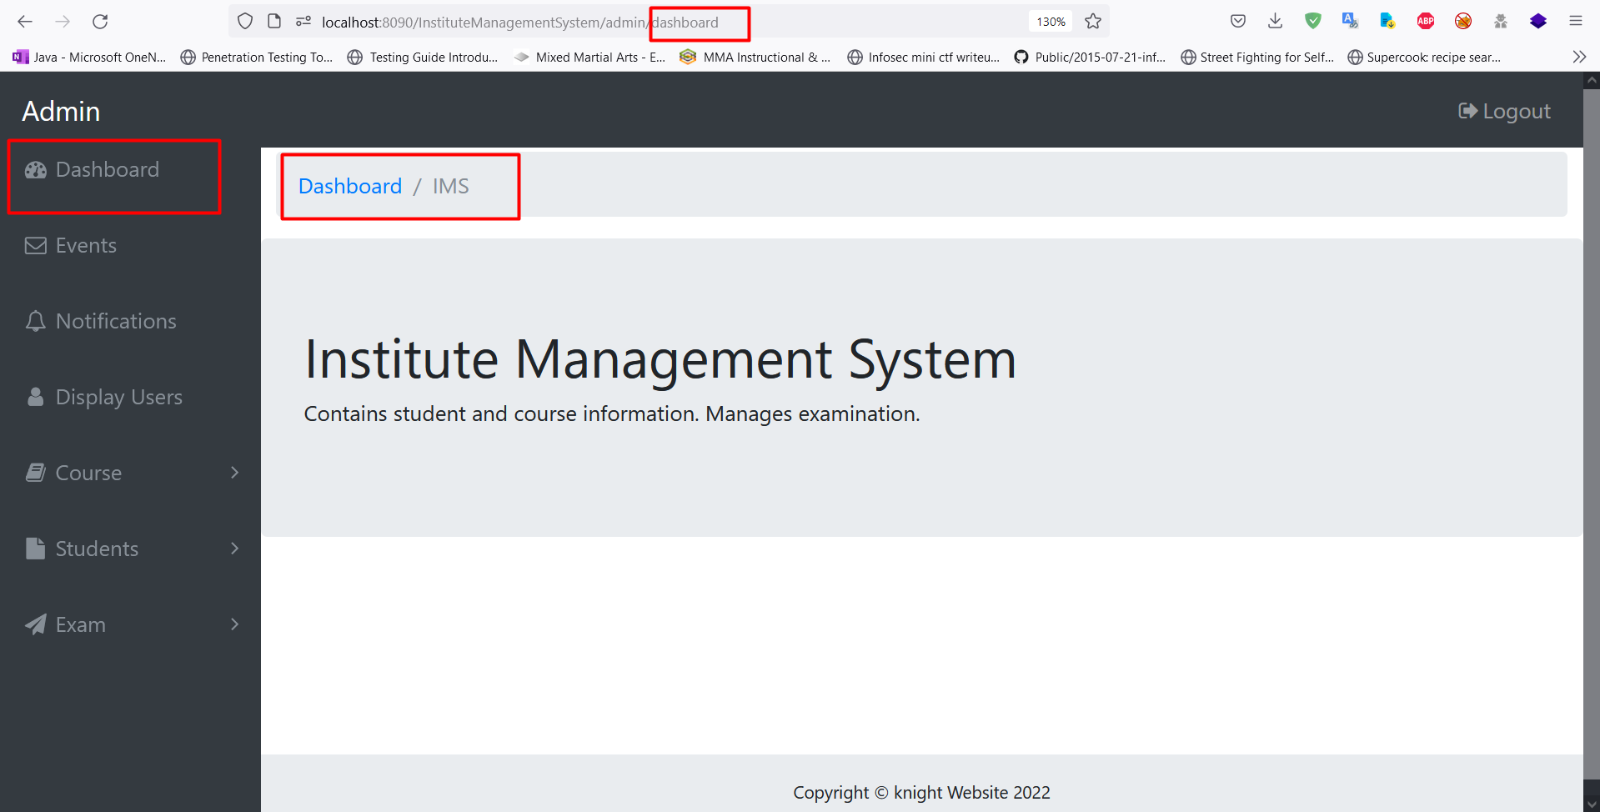
9. Dashboard

Slide 12
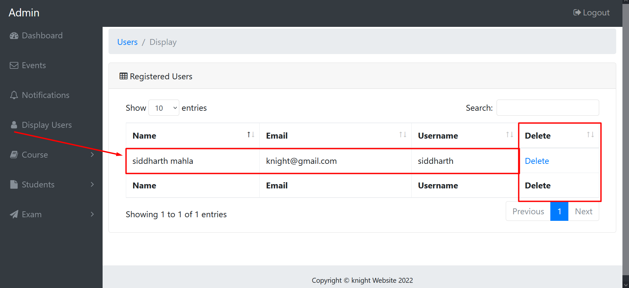
10. Registered Users

Slide 13
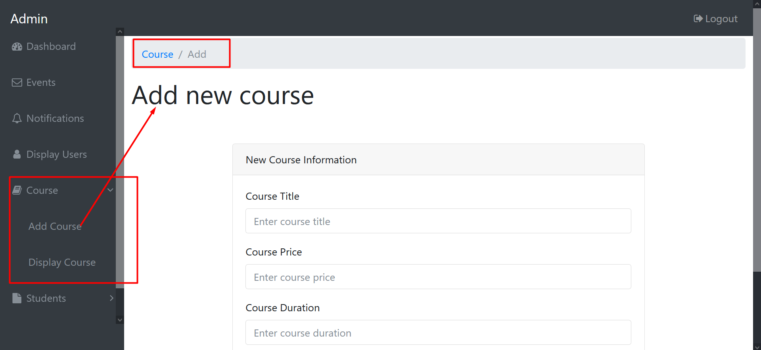
11. Add new course

Slide 14
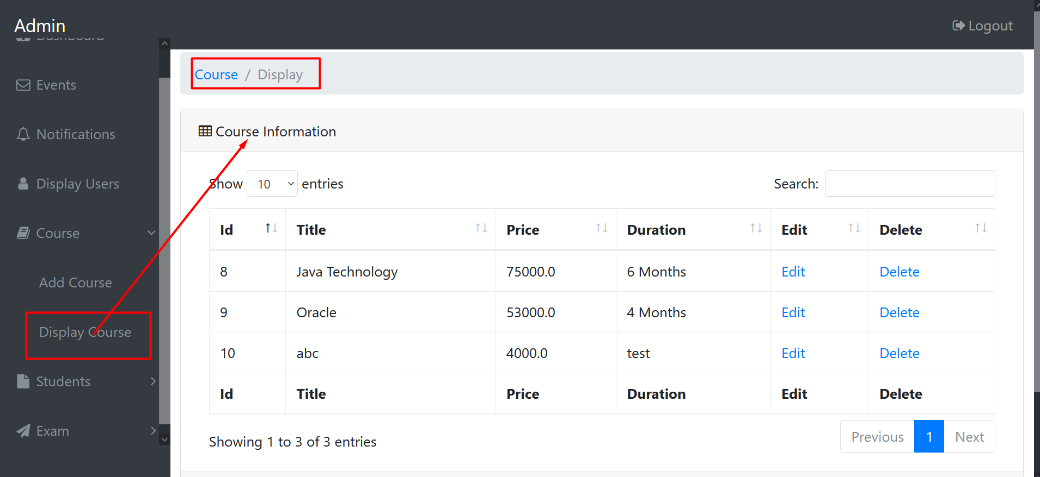
12. Display Added Courses

Slide 15
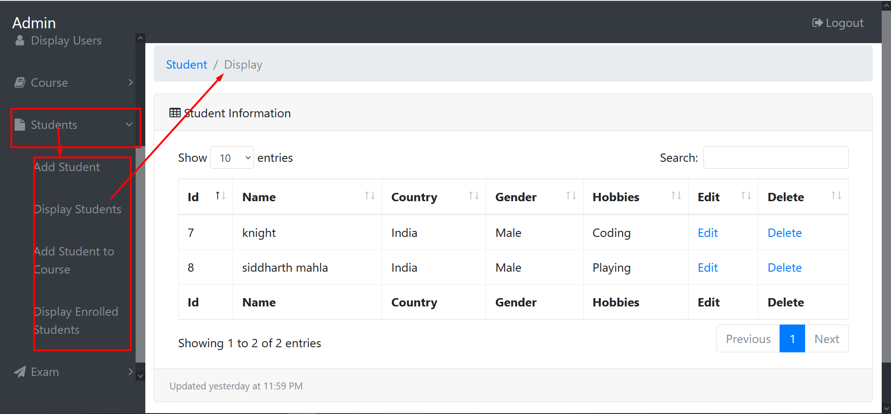
13. Display Added Students

Slide 16
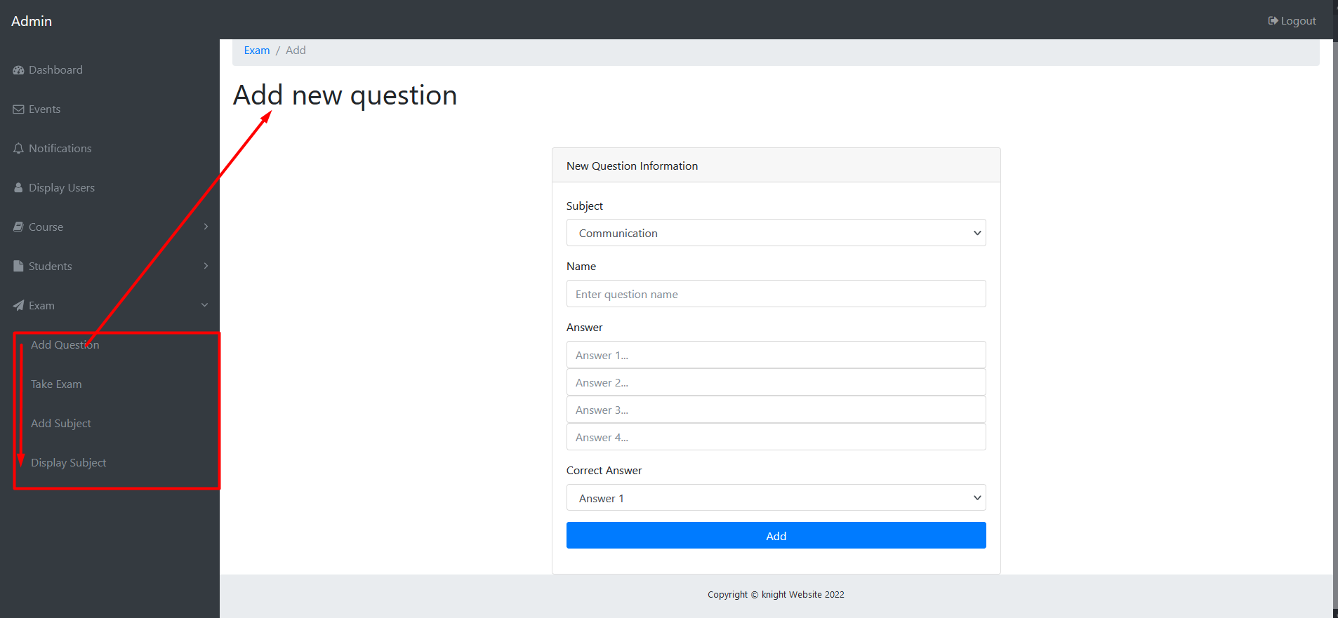
14. Exam Module: Add Question, Add Subjects, Display Subjects, Take Exams.

